Slide 1


SENTIMENT ANALYSIS IN THE ERA OF LARGE LANGUAGE MODELS: A REALITY CHECK
Presented By:
Nasima Akter
ID: 221-15-4755
Section: 61_A

Slide 2

OUTLINE
• Introduction
• Research Objective
• Literature Review
• Methodology
• Experimental Analysis
• Conclusion
• Reference

Slide 3

INTRODUCTION
Sentiment analysis (SA), a vital task in natural language processing, involves identifying emotions and opinions in text. The rise of large language models (LLMs) like GPT-3 and Flan-T5 has sparked interest in their performance on SA tasks. While LLMs excel in many NLP applications, their effectiveness in SA compared to smaller, domain-specific models remains an open question. This presentation examines the state of SA in the era of LLMs.

Slide 4
RESEARCH OBJECTIVE
To Investigate the performance of large language models (LLMs) like GPT-3 and Flan-T5 on various sentiment analysis tasks.
To Compare the performance of LLMs with smaller, domain-specific language models (SLMs), focusing on zero-shot and few-shot learning scenarios.
To Analyze current evaluation practices for sentiment analysis tasks and propose improvements to better assess LLM performance.
To Introduce the SENTIEVAL benchmark for more comprehensive and realistic evaluation of sentiment analysis models, addressing the limitations of existing methods.

Slide 5
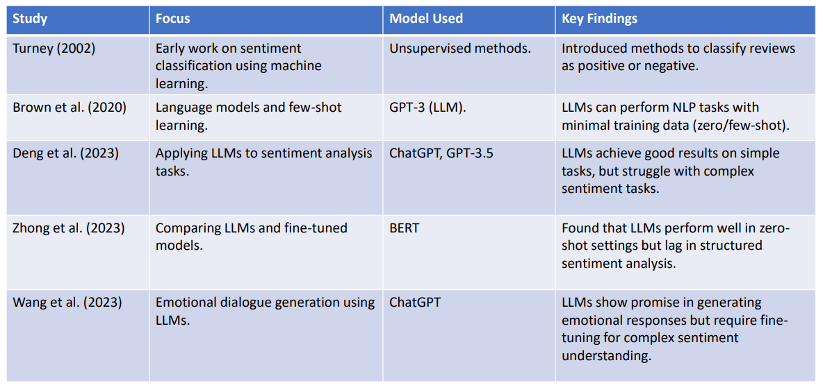
LITERATURE REVIEW

Slide 6
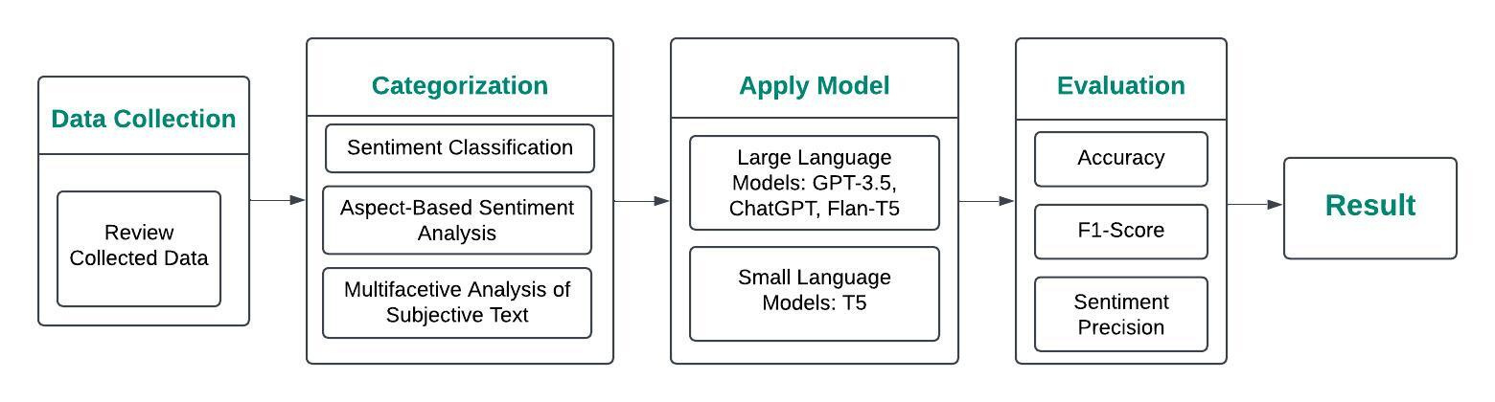
METHODOLOGY

Slide 7
EXPERIMENTAL ANALYSIS
1. Evaluation Setup
•Models: LLMs (GPT-3, ChatGPT, Flan-T5) vs. SLMs (T5).
•Tasks: Sentiment Classification (SC), ABSA, and MAST.
•Learning Modes: Zero-shot and few-shot.
2. Performance Metrics
•Accuracy, F1-Score, Sentiment Precision.
3. Results Summary
•Zero-shot: LLMs perform well on simple tasks but struggle with complex tasks.
•Few-shot: LLMs outperform SLMs, especially with limited data.
4. Insights
•LLMs are strong in general tasks but sensitive to prompt design.
•Few-shot learning helps LLMs with complex, structured tasks.

Slide 8

CONCLUSION
Large Language Models (LLMs) excel in simpler sentiment analysis tasks and zero-shot learning but struggle with fine-grained tasks like aspect-based sentiment analysis (ABSA). Domain-specific small language models (SLMs) often outperform them when fine-tuned. The study highlights the need for effective prompt design and comprehensive benchmarks like SENTIEVAL to evaluate LLMs' SA capabilities.

Slide 9

REFERENCE
1.Turney, P. D. (2002). Thumbs up or thumbs down? Semantic orientation
applied to unsupervised classification of reviews. ACL.
2. Hu, M., & Liu, B. (2004). Mining and summarizing customer reviews. ACM
SIGKDD International Conference on Knowledge Discovery and Data Mining.
3. Brown, T. B., Mann, B., Ryder, N., et al. (2020). Language models are few-shot learners. Advances in Neural Information Processing Systems (NeurIPS).
4. Zhong, Z., Ding, L., Liu, J., et al. (2023). Can ChatGPT understand too? A
comparative study on ChatGPT and fine-tuned BERT. CoRR.
5. Wang, J., Xie, Q., Ding, Z., et al. (2023). Is ChatGPT a good sentiment
analyzer? A preliminary study. CoRR.

Slide 10
Thank
You

